Slide 1

Recognition of Bangladeshi Sign Language Words using Machine Learning Algorithm
Presented By-
Name: Md. Habibur Rahman
ID: 241142
Supervisor: Professor Shamim Al Mamun, PhD

Slide 2
Introduction
Importance of Bangladeshi Sign Language for the hearing-impaired community.
Addressing the communication gap for the hearing-impaired in Bangladesh.
Develop a machine learning system for accurate and real-time recognition of BdSL gestures.
Significance of overcoming the communication barrier and creating an inclusive society.

Slide 3
Objectives
Develop an Automated Machine Learning System: To create a system capable of recognizing Bangla Sign Language (BdSL) gestures.
Utilize Deep Learning Models: To employ deep learning models such as VGG16, VGG19, and Support Vector Machines (SVM) for accurate classification of BdSL gestures.
Improve Model Performance Through Preprocessing: To preprocess BdSL gesture data with techniques like resizing, normalization, and augmentation to enhance model performance.
Evaluate System Performance: To assess the model's performance through training and testing accuracy, ensuring high accuracy and low overfitting.

Slide 4
Literature Review
Model / Work | Key Features / Contributions | Accuracy (%)
Ma et al. (2020) | Applied deep learning-based neural networks to diagnose chronic diseases, demonstrating the efficacy of CNNs for complex data | Not specified
Golan et al. (2018) | Utilized machine learning algorithms (SVM) to detect early signs of Autism Spectrum Disorder, highlighting SVM's potential for pattern recognition | ~85%
Zhang et al. (2019) | Addressed real-time gesture recognition by integrating CNNs with data augmentation techniques, improving model robustness across environmental variations | ~90%
Simonyan and Zisserman (2014) | Proposed VGG16 and VGG19 architectures, which are known for their deep structure and excellent performance on image classification tasks | ~94% (VGG16)
Choi et al. (2020) | Integrated lightweight CNNs to optimize gesture recognition speed, enabling real-time application on mobile devices | ~92%
Li et al. (2021) | Developed a hybrid deep learning model combining CNN and decision trees, achieving improved accuracy and reduced model complexity | ~87%
Wang et al. (2021) | Applied 3D CNNs to capture temporal and spatial features in dynamic gestures, improving recognition accuracy for moving hands | ~93%

Slide 5
Tools and Technology
Python was used for developing machine learning models and data processing.
Scikit-learn: Implemented machine learning algorithms
TensorFlow/Keras: Used for building and training the Convolutional Neural Network (CNN) model.
Pandas: Handled data manipulation and preprocessing tasks.
NumPy: Used for numerical operations and handling arrays/matrices.
Matplotlib/Seaborn: Utilized for visualizing results, confusion matrices, and accuracy/loss metrics.
Google Colab: Used for GPU support when training deep learning models like CNN.

Slide 6
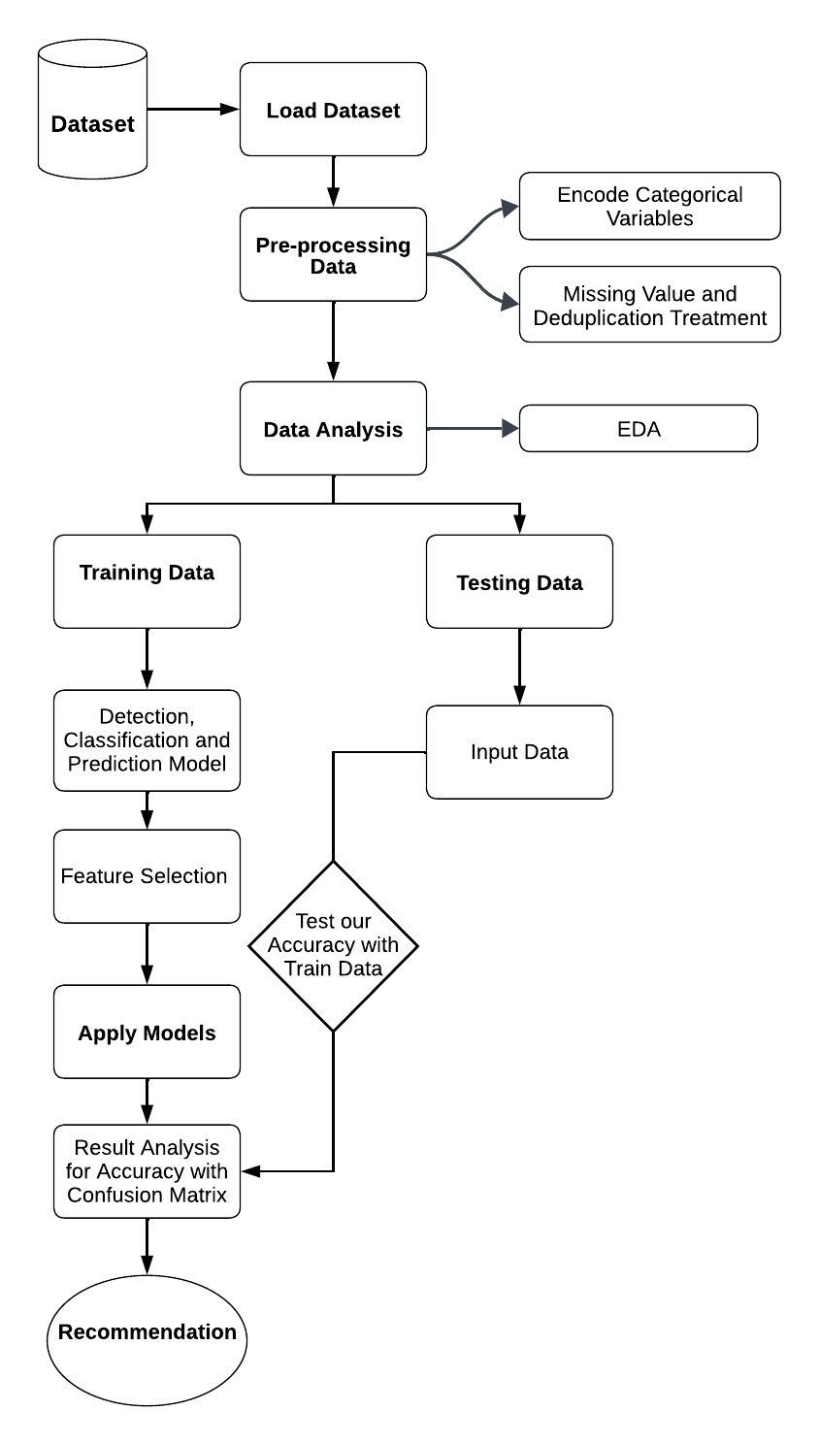
Overview of the Proposed System Methodology

Slide 7
Research Methodology
Dataset Preparation: Collecting and preprocessing BdSL gesture data (image resizing, normalization, and augmentation).
Model Selection: Use of VGG16, VGG19, CNN, and SVM models.
Transfer Learning: Employing pre-trained models (VGG16, VGG19) to improve performance with a small dataset.
Model Training & Evaluation: Training on a custom BdSL dataset and evaluating using accuracy, precision, recall, and F1-score.

Slide 8
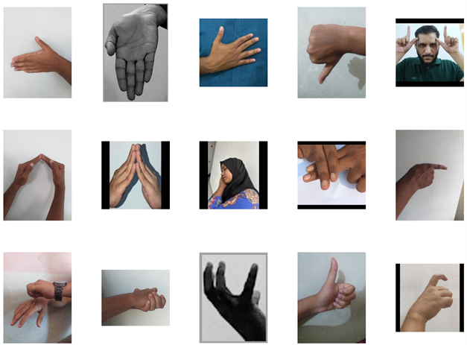
Sample images for each BdSL class showing different gestures performed foreach label.
These images represent the hand shapes and movements for the corresponding BdSL words.

Slide 9
Experimental Results
Model Performance: Comparing VGG16, VGG19, CNN, and SVM models.
Overfitting and Generalization: Challenges of overfitting in models like VGG16 and custom CNN.
Best Model Evaluation: VGG19 demonstrated the best generalization with high test accuracy.
Real-World Applications: Integration of the model into web applications to improve accessibility for the hearing-impaired community.

Slide 10
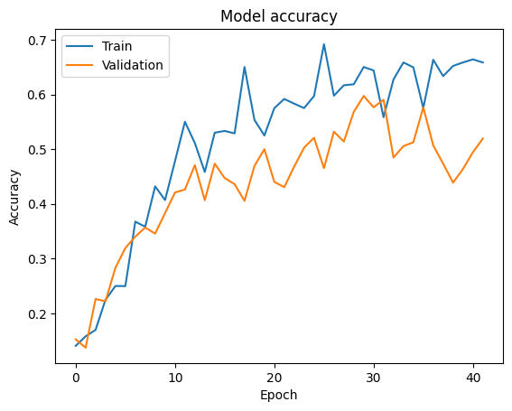
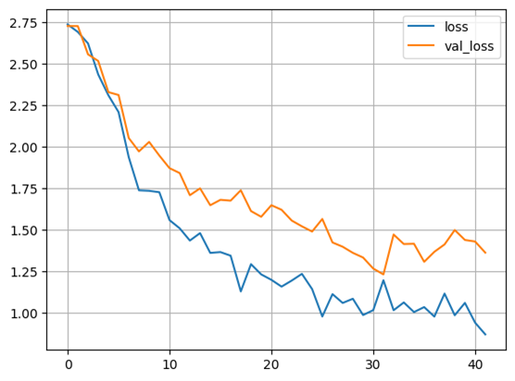
Custom Hybrid Model

Slide 11
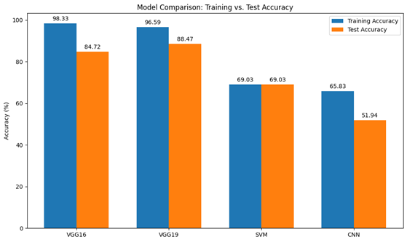
Comparison of training and test accuracy between different models.
The barchart compares VGG16, VGG19, SVM, and CNN models based on their performance during training and testing

Slide 12
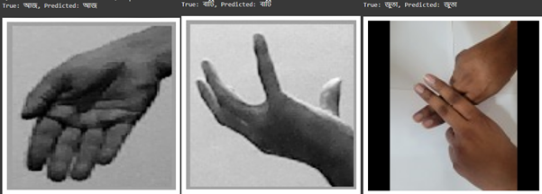
Output Results
Sample output showing true and predicted labels for BdSL gestures.
The images depict the comparison between the true label and predicted label for different gestures.

Slide 13
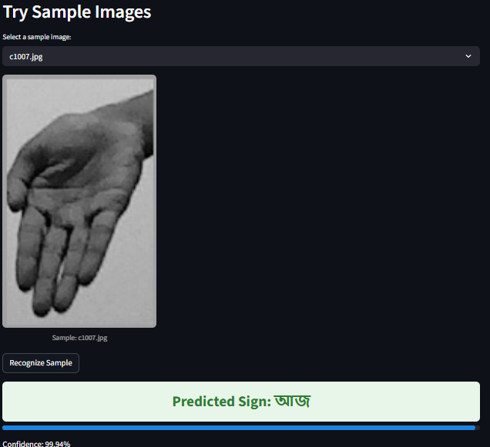
Web Application

Slide 14
Impact on Society
Social Impact: Bridging the communication gap for the hearing-impaired community and promoting inclusivity.
Sustainability: The potential for future system development and scalability in educational and healthcare sectors.
Long-Term Vision: Creating real-time, scalable BdSL recognition systems that integrate with mobile applications and wearable devices.

Slide 15
Conclusion
Summary of Findings: VGG19 is the best-performing model for BdSL gesture recognition.
Future Work: Expanding the dataset, improving model performance, and addressing real-world conditions for real-time applications.
Recommendations: Incorporating additional data features, expanding the dataset diversity, and exploring advanced model architectures.

Slide 16
References
Ma et al. (2020), "Detection and diagnosis of chronic kidney disease using deep learning-based heterogeneous modified artificial neural network," Future Generation Computer Systems, vol. 111, pp. 17–26, 2020.
Golan et al. (2018), "Early detection of autism spectrum disorder using machine learning," Journal of Medical Systems, vol. 42, no. 1, p. 53, 2018.
Zhang et al. (2019), "Real-time gesture recognition using convolutional neural networks and data augmentation techniques," International Journal of Computer Vision, vol. 127, no. 6, pp. 675–688, 2019.
Simonyan and Zisserman (2014), "Very deep convolutional networks for large-scale image recognition," arXiv preprint arXiv:1409.1556, 2014.
Choi et al. (2020), "Efficient gesture recognition using lightweight convolutional neural networks," IEEE Access, vol. 8, pp. 131344–131352, 2020.
Li et al. (2021), "A hybrid deep learning model for gesture recognition using CNN and decision trees," Pattern Recognition Letters, vol. 145, pp. 12–18, 2021.
Wang et al. (2021), "3D convolutional neural networks for dynamic gesture recognition," IEEE Transactions on Image Processing, vol. 30, pp. 484–495, 2021.

Slide 17
THANK YOU

